Slide 1
Sharing Values मूल्यों पर संवाद
Notes:
GP Bagaria, Feb 2022
YouTube Recording: https://www.youtube.com/watch?v=j2esbepGCWg
Raw Recording: https://1drv.ms/u/s!AtTMLVuvJm2P-lfV-yjQnS1DS9DG?e=m7ANAS

Slide 2
What to Share?
What to Share?- सह-अस्तित्व, व्यवस्था, संबंध- है, होना, करना में, से, के लिए
How to Share?- सह-अस्तित्व, व्यवस्था, संबंध-पूर्वक
Why to Share?- सह-अस्तित्व, व्यवस्था, संबंध- के लिए

Slide 3
What to Share?- Existential Reality (अस्तित्व सहज वास्तविकता)
सह-अस्तित्व, व्यवस्था, संबंध- है, होना, करना में, से, के लिए
  जो कुछ है, सह-अस्तित्व, व्यवस्था, संबंध पूर्वक है,
  जो कुछ होना है, सह-अस्तित्व, व्यवस्था, संबंध पूर्वक होना है,
  जो कुछ करना है, सह-अस्तित्व, व्यवस्था, संबंध पूर्वक करना है,
  सह-अस्तित्व, व्यवस्था, संबंध- है
        सह-अस्तित्व- शून्य में संपृक्त इकाइयां- जड़, चेतन्य
        व्यवस्था- स्वयं में, हर इकाई में
        संबंध- परस्परता में, हर इकाई की दूसरी इकाई की परस्परता में
    Expressed as harmony at different levels- human being, family, society, nature/existence
  सह-अस्तित्व, व्यवस्था, संबंध- होना- जो कुछ हो रहा है, होना है, वह सह-...पूर्वक हो रहा है, होना है
  सह-अस्तित्व, व्यवस्था, संबंध- करना जो कुछ करना है, करवाना है, वह सह-...पूर्वक करना है, करवाना है

Slide 4
Existence
(= Co-existence = Units submerged in Space)
Units (Nature)
Space (All-pervading)
Limited in size
Unlimited
This is already in harmony
Activity, Active
No activity
Self-organized
Energized
Recognises the relationship and fulfills
Material tM+
Consciousness (Self) pSrU;
Temporary
Continuous
Recognising, Fulfilling
Knowing, Assuming, Recognising, Fulfilling
Physical Order
Bio Order
+
Animal Order
Atom
Cell
Only this part is remaining
And it has to happen in the Self by the Self
+
Molecule
Plant
Human Order
Molecular Structure
Animal Body
Right Understanding &
Right Feeling
Development
Linear – Not Cyclic
Lump
Fluid
Human Body
No Development
Cyclic
Definite Human Conduct
uf”pr Ekkuoh; vkpj.k

Slide 5
Knowing, Assuming, Recognizing, Fulfilling
Knowing, Assuming, Recognizing, Fulfilling or Assuming (without knowing), Recognizing, Fulfilling
KNOWING To see the reality as it is, in its completeness, by direct observation
It is definite, continuous and universal
E.g. What is the existential reality Human being = ?, Purpose of human being = ?,
Is the purpose same of (or) different?...
ASSUMING What I accept about that reality, which may or may not be same as the reality as it is
(acceptance can be on the basis of knowing the reality in completeness or
acceptance can also be without knowing the reality in completeness,
i.e. one has not seen the reality or not seen it in its completeness
but assumed something about it)
E.g. I hear that human being = co-existence of Self and Body, but when I have to decide something related to
a human being (me or another), what I have really accepted about human being or that particular human being
comes to the foreground and I decide on the basis of my acceptance (which may or may not match
with the existential reality)
RECOGNISING My relationship with that reality (human being or rest of nature).
I recognise my relationship with any reality and make effort to fulfil that relationship based on my assuming
E.g. If I assume human beings have different purposes, my behaviour with different human beings is different
FULFILLING The relationship with that reality (human being or rest of nature)
E.g. My behaviour with a human being that I recognise as a friend is one way
My behaviour with a human being that I recognise as an enemy is another way

Slide 6
FAQ
What is the need for assuming after knowing?

Slide 7
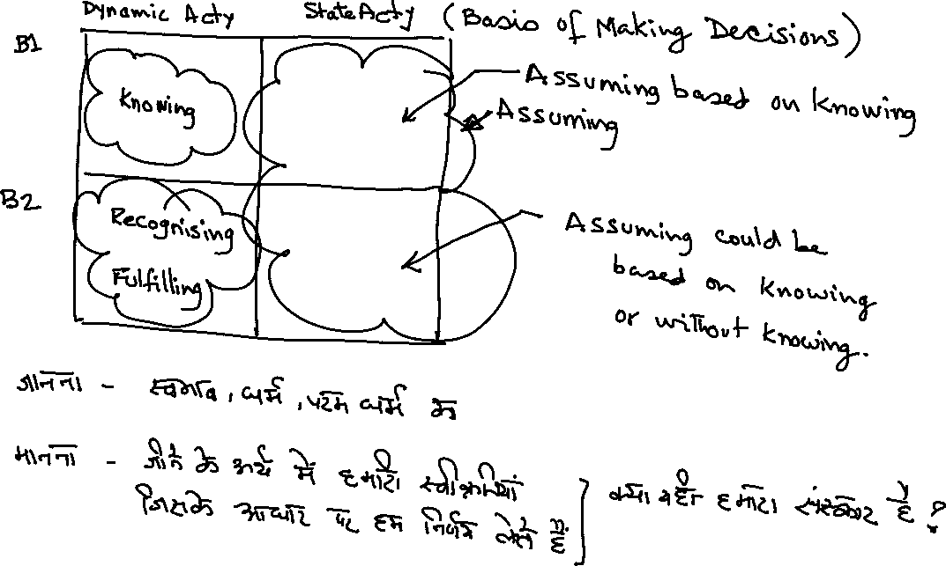

Slide 8
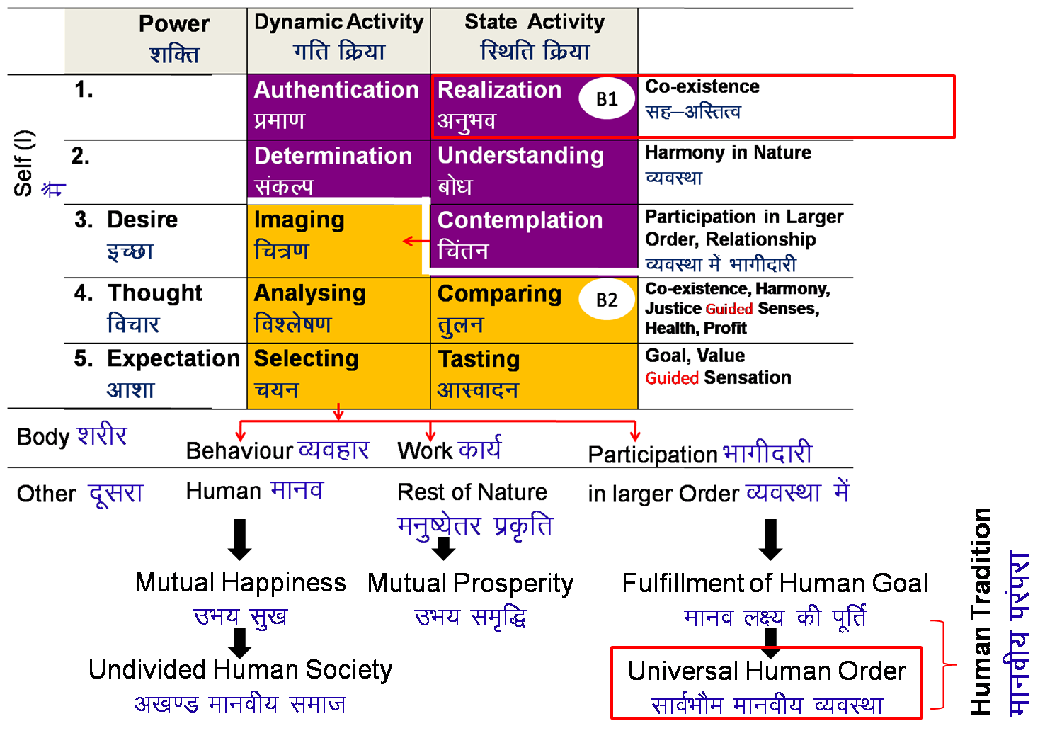
Existence
(= Co-existence = Units submerged in Space)
Universal Order
सार्वभौम व्यवस्था
Units (Nature)
Space (All-pervading)
Limited in size
Unlimited
Activity, Active
No activity
Self-organized
Energized
Recognises the relationship and fulfills
Material tM+
Consciousness pSrU;
(Self)
Temporary
Continuous
+
Recognising, Fulfilling
Knowing, Assuming, Recognising, Fulfilling
+
+
Animal Order
Human Order
Physical Order
Bio Order
Atom
Cell
Molecule
Plant
Development
Linear – Not Cyclic
Molecular Structure
Animal Body
Lump
Fluid
Human Body
No Development
Cyclic

Slide 9

What to Share?- Existential Reality (अस्तित्व सहज वास्तविकता)
  मानव को
  सह-अस्तित्व, व्यवस्था, संबंध- को समझना है- अनुभव, बोध, चिंतन
        सह-अस्तित्व- शून्य में संपृक्त इकाइयां- जड़, चेतन्य
        व्यवस्था- स्वयं में, हर इकाई में
        संबंध- परस्परता में, हर इकाई की दूसरी इकाई की परस्परता में
  सह-अस्तित्व, व्यवस्था, संबंध- के अर्थ में होना है- भाव, विचार
  सह-अस्तित्व, व्यवस्था, संबंध- के अर्थ में करना- व्यवहार, कार्य, व्यवस्था में भागीदारी करना है
  इस आधार पर हम स्वयं सुखी रहते है,
  दूसरों को सुखी करने की संभावना बनाते हैं, सभी को सुखी करने की संभावना बनाते हैं.
  इससे अन्यथा हम मान सकते हैं, उस आधार पर कल्पना कर सकते हैं, पर अन्यथा हो नहीं सकता,
  इससे अन्यथा हम मानते हैं, उस आधार पर कल्पना करते हैं-
  तो हम दुखी होतें हैं, दूसरों को दुखी करने की संभावना बनाते हैं.

Slide 10
Human Aspiration & Program for its Fulfillment
Human Aspiration- Continuity of Happiness
Happiness = To be in Harmony
Program
To understand harmony and to live in harmony at all levels of being
  In the Human Being
  In the Family
  In the Society
  In Nature/Existence
1
Verify the proposals
on the basis of your NATURAL ACCEPTANCE
b) Experiential validation
by LIVING ACCORDINGLY
2
Right Understanding
Right Feeling

Slide 11
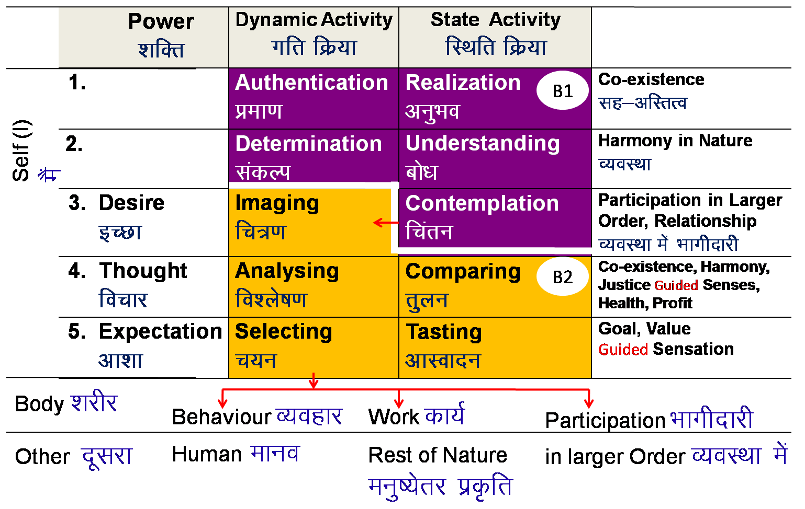
Realisation of Co-existence & it’s expression – Universal Human Order
REALISATION WITHIN
Mutual Happiness
mHk; lq[k
Mutual Prosperity
mHk; le`f)
Fulfillment of Human Goal
Ekkuo y{; dh iwfrZ
Human Tradition
ekuoh; ijaijk
Undivided Human Society
v[k.M ekuoh; lekt
EXPRESSION OUTSIDE
Universal Human Order
lkoZHkkSe ekuoh; O;oLFkk

Slide 12
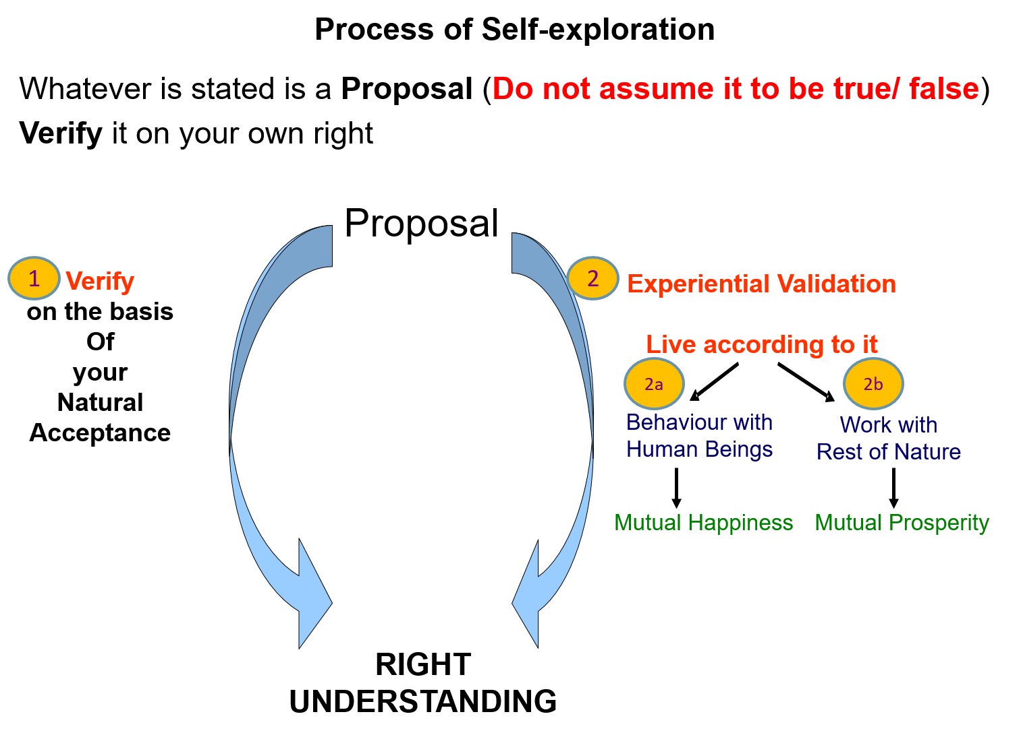
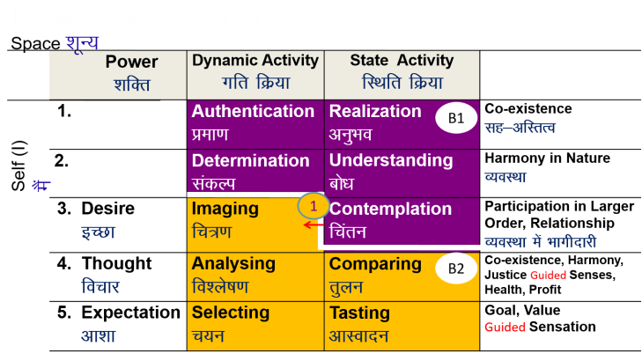
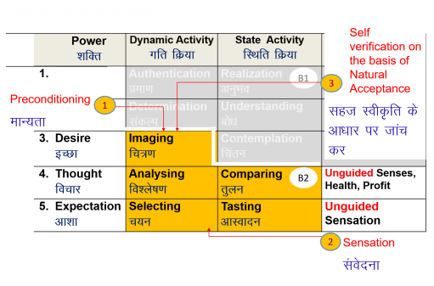
Program of Action (Individual) – 1: Develop Right Understanding
Self-exploration
Verify the proposals
(on your own right)
    Right understanding of harmony at all levels
    (human being, family, society, nature/existence)
    Feeling and thought
    of harmony
    Harmonious behaviour, work and participation in larger order

Slide 13
Program of Action (Individual) – 2: Purification of Sanskar
Self-awareness – Be aware of your desire, thought and expectation – every moment
Self-evaluation – Evaluate your desire, thought and expectation
    – on the basis of your Natural Acceptance
Sanskar =
Acceptances derived out of
∑ [Desire + Thought + Expectation]
from all time
&
Acceptances derived out of right understanding
Sanskar (t+1) =
Sanskar (t) +
Environment (t) +
Self-exploration (t)

Slide 14

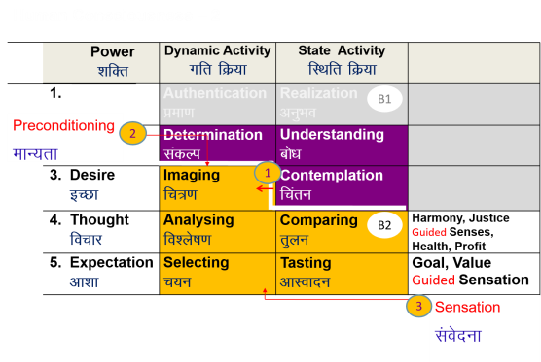
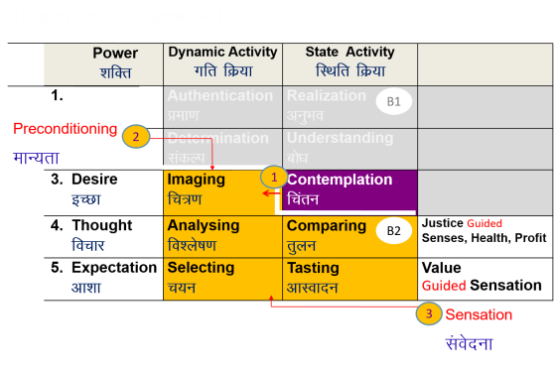

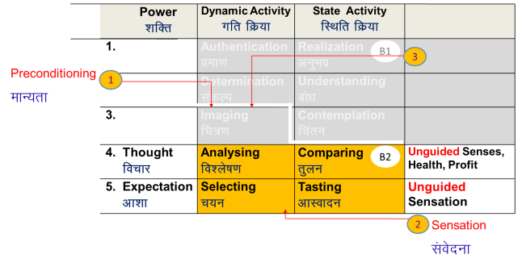
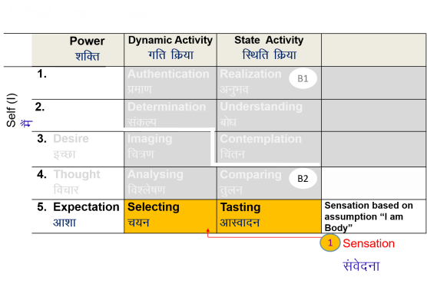
Self-evolution
Self-exploration
Self-verification
Human Consciousness
Living on the basis of knowing
Happiness by being in harmony within and harmony in all aspects of being
Acceptance of relationship – from one to many, to all [HAPPINESS]
Identifying need, production, right utilisation of physical facility [PROSPERITY]
Participation in larger order, expanding harmony [SOCIETAL DEVELOPMENT]
Transformation / Development
Preparation for Transformation
Living on the basis of assuming (without knowing)
Happiness from outside (through feeling from the other, sensual pleasure and physical facility)
Domination and opposition in relationship [UNHAPPINESS]
Exploitation and indulgence [DEPRIVATION]
Exploitation in larger order, increasing disorder [DEGRADING SOCIETY]

Slide 15
This Whole Content is Shared thru
UHV Content
Issues in the current situation- solution-focussed, problem-focussed both, Exploring into them to get an understanding of the concerned reality and possible solutions
Basic introduction to human aspiratiion of continuous happiness and its fulfillment through understanding of Harmony at different levels of existence and living accordingly
Understanding Human Being, Nature and Existence in detail.
Vision for a Humane Society- Role of human being and its expression in relationship and system in the Humane Society
Human Values (based on understanding of existential realities) in different darshans/ traditions in the past and present
Human Psychology- based on the understanding of existential realities as co-existence, harmony, relationship and human being as co-existence of self and body
Human Sociology- based on the understanding of existential realities as co-existence, harmony, relationship and human behaviour as mutual fulfillment with human being and rest of nature
Human Economics- based on the understanding of existential realities as co-existence, harmony, relationship and economics as the process of ensuring nurturing, protectIon and right utilisation of nature (including both human being and rest of nature)

Slide 16

How to Share?
What to Share?- सह-अस्तित्व, व्यवस्था, संबंध- है, होना, करना में, से, के लिए
How to Share?- सह-अस्तित्व, व्यवस्था, संबंध-पूर्वक
Why to Share?- सह-अस्तित्व, व्यवस्था, संबंध- के लिए

Slide 17
How to Share?
What to Share?- सह-अस्तित्व, व्यवस्था, संबंध- है, होना, करना में, से, के लिए
How to Share?- सह-अस्तित्व, व्यवस्था, संबंध-पूर्वक
सह-अस्तित्व में अनुभव पूर्वक ,
व्यवस्था का बोध पूर्वक ,
संबंध का चिंतन, संबंध की स्वीकृति –पूर्वक
संबंध की स्वीकृति, संबंध में भाव- विश्वास, स्नेह, वात्सल्य ...पूर्वक
संबंध में भाव पूर्वक संवाद, आदान-प्रदान ही मूल विधि है

Slide 18
Role of Teacher – Co-explorer Sharing thru Feeling of Relationship
Is clear that the student wants to be happy, make other happy… therefore wants to understand, can understand… but may have difficulty in understanding may have less understanding than the teacher, so may make more mistakes… feeling of trust
Has the feeling of responsibility to guide the student… but may have difficulty in explaining purpose of sharing – to help initiate/strengthen self-exploration feeling of guidance
To ensure definite human conduct in himself/herself or at least make consistent effort for excellence (as a co-explorer)
If the student is able to see that the teacher is happy, motivated, eager to share… is excellent or making effort for excellence, is more responsible than me… s(he) develops a feeling of reverence/glory, is able to accept the teacher and becomes willing to learn-understand from the teacher
Otherwise the student is not able to accept the teacher…

Slide 19
Practice
Also Observe
Introduction as a co-explorer
(connect to the students)
Proposal (elaborate the proposal or a key point about the proposal)
Pause (time for self-reflection)
small example, etc.
reflective questions
dialogue, q&a…
Return to the proposal
Next proposal (or next key point) ...
In the Sequence
Feeling…
I want to help the other to understand
I want to impress the other
I want to complete the syllabus…
Proposal placed with clarity (80% time for this) – talking about problem only when essential, for drawing attention to need of the solution
Examples (small, that clarify the proposal)
Reflective questions
Helping to explore the proposal?
evaluate oneself?
evaluate other for complimentarity?
% time used for Q&A and dialogue
Talking outside the context
Harping on what it is not Trying to convince

Slide 20
Session
State session topic clearly
Initiate dialogue
(that helps participants to explore, evaluate, understand the content and see its relevance to their life)
Discuss it as a series of connected key points (sub-proposals)
  Key point as a proposal Next key point
  Expand / explain it
  Take small real-life examples to exemplify key point (with enthusiasm and liveliness)
  Ask questions to participants to explore the key point
  Ask participants if they are able to explore the key point
  Pause, give time for self-exploration
  Respond to clarifications, questions, observations
  Return to key-point before proceeding
Sum up the topic
Give points for self-reflection as home-work
(try to avoid hesitations “umm..” or repeating words like “right”, “hai na”, “theek hai”…)

Slide 21
Proposal / Key Point
Common Mistakes
Proposals are about
What is e.g. human being
What is my role with it e.g. trust
Place the proposal clearly
Elaborate with 1 or 2 connected key points
(gently unfold from known to unknown, help participants to explore, evaluate, understand the key points of the proposal and see the relevance of the proposal to their real life)
Place the proposal before asking questions (ask questions only when sufficient elaboration has been made, and we feel students have grasped the proposal)
Discussion may selectively contain
What it is not e.g. over evaluation
Evaluation of prevailing state
Asking questions about the topic, before placing a proposal about it in sufficient detail
Mixing one’s preconditioning with the proposal
Shifting to do’s and don’ts
Explaining details that are to be covered later or in higher-level workshops, using uncommon language, giving long explanations or examples
Bringing up or discussing controversial issues, focusing on problems
Focus on evaluating current state of being vs helping participant to understand the proposal

Slide 22
Asking Questions
Exploratory questions, “what is it”
Self-verification → understanding the reality
(self, body, family, society, nature/existence)
Help to reach out to one’s higher potential to observe through the Self, understand
e.g. Human being = coexistence of Self and Body
e.g. Self – imagination and natural acceptance
e.g. Feeling of trust = clarity in me – that the natural acceptance of the other is the same as mine

Slide 23
Asking Questions
Reflective questions, “what is my role with it”
Self-exploration → understanding my role with it (self, body, family, society, nature/existence)
Evaluative questions about me,
“do I know it, am I fulfilling my role with it”
Help to reach out to one’s natural acceptance
(not merely the imagination, the likes-dislikes, experience of events…)
About what to do (not about how to do)
e.g. to live in relationship with human being
e.g. to nurture the Body
Help to evaluate oneself, connect to their life
(and later develop a program for self-improvement)
e.g. Am I living with a feeling of relatedness? With all human beings?
e.g. Am I selecting food for nurturing my Body (or merely for taste)? Always?

Slide 24
Asking Questions
Evaluative questions about me,
“do I know it, am I fulfilling my role with it”
Evaluative questions about other, the situation
Help to evaluate oneself, connect to their life
(and later develop a program for self-improvement)
e.g. Am I living with a feeling of relatedness? With all human beings?
e.g. Am I selecting food for nurturing my Body (or merely for taste)? Always?
Help to evaluate the other, the situation and
Draw inspiration from other
Identify one’s role with other
Identify one’s role in the situation
e.g. identify how one can be complimentary in a relationship

Slide 25
Asking Questions Common Mistakes
Exploratory questions, “what is it” (the reality)
Self-verification → understanding the reality (self, body, family, society, nature/existence)
Reflective questions, “what is my role with it”
Self-exploration → understanding my role with it
Evaluative questions about me,
“do I know it, am I fulfilling my role with it”
Evaluative questions about other, the situation (with a view to ensure comlementarity)
Trying to convince
Preaching
Shifting to dos and don’ts
Becoming judgemental, rejecting other, avoiding responsibility

Slide 26
Responding to Questions / Comments
When they start, … respond with their name and a word of welcome
Listen to whole question / comment
(interrupt only in exceptional cases…)
Rephrase the question / comment, if formulation is not clear
Validate that this is their question / comment
If they interrupt, listen first
Short, crisp answer keeping in mind what has been covered so far and the type of workshop
(do not go beyond this)
Respond with smaller proposal that they can explore – they should be able to connect the answer to a proposal that has already been discussed
Respond with wide fundamental answer covering (individual, family/society, nature, time frame…)
Keep pausing to let them interject, respond
Sum up, if the dialogue is long
After the interaction, recall and repeat the proposal being discussed
In case of comment or observation
Acknowledge them. Generally nothing else is required (no need for agreeing or disagreeing or commenting)

Slide 27
Responding to Questions / Comments
Observe:
  Your feeling (how I can help the other to understand or how I can shut up the other, etc.)
  Are you really clear about the answer
Common Mistakes:
  Not connecting person-to-person, not acknowledging them, just giving instructions, ‘we can hear you go ahead’ etc.
  Not listening or interrupting
  Trying to answer everything (as if it is our viva-voce examination)
  Raising or getting involved in controversial issues
  Just repeating the proposals
  Long answers, dominating, trying to convince
  Addressing some other issue than the one raised
  Cross questioning, counter questioning
  Giving prescriptions or readymade answers, do’s and don’ts

Slide 28
Responding to Questions
Questions are about some part of an existential reality which is not yet clear/understood
Response
Identify the reality about which the question is
Help other to identify that part of the reality which the other is already able to see
Help other to explore the part which is unclear (go from known to unknown, in small steps)
(If they are able to find the answer to their question themselves, your response is helping them to develop, not otherwise)
Response may also address the width (to help see the reality in its completeness)
Self (imagination, natural acceptance)
Body, family (human-human relationship)
Society (relationship, systems like education)
Nature/Existence (mutual fulfilment, co-existence)
- Motivation to find out (explore… research) the details, place in mainstream education…

Slide 29
Example: How can you say that Human Being = Co-existence of Self and Body
Reality: Human Being
Part that seems to be clear: Body
Part that may be unclear: Self
Proposal(s) to explore: Activity of Body is temporary Activity of Self is continuous
Self-Observation: Any work you take from the Body is temporary
The Body gets tired after some time. Can you see this?
Try to be aware of your own imagination…
Try to stop it… can you stop it?
  Is it going on in some part of your Body or in You (Self)?
Expected Conclusion: There are 2 types of activities in me
One is temporary, the other seems to be continuous
I may not be just the Body… I will explore further…

Slide 30
Other Ways of Communicating a Proposal
We have discussed
  Placing a proposal through dialogue
  Asking questions
  Responding to questions
Other ways of communicating and helping the other to explore include:
  Assignments, exercises and practice sessions
  Video of lectures or other videos
  Reading material (could be multi media)
  Case studies
  Projects
These may become necessary and important when the faculty is not present, as is the case of on-line, self-learning mode. Of course, these must be followed up with dialogue and Q&A

Slide 31
Example: Exercise / Assignment 3.1 (in UHV-I)
Take your list of aspirations + concerns (from session 1 home assignment).
Find out what is needed to fulfill your aspirations + address your concerns:
  – right understanding (clarity)
  – relationship (right feeling)
  – physical facility (money, some real physical facility like food, clothes, shelter, mobile…)
eg. Aspiration/Concern right und relationship physical facility, body
Money ? ?  (salary…)
Name, fame, attention   
good food ? ?  (food)
latest bike ? ?  (bike)
peace of mind   (family & friends)
good health   

Slide 32
Conclusions from Self-exploration, self-verification and Self-evaluation
Analyse your list of your aspirations + concerns Find out what is needed to fulfill them:
  – right understanding – relationship (right feeling) – physical facility
Aspiration
/Concern right und relationship physical facility, body
Money    (salary…)
But with a base of relationship & right understanding
Good friends   
But with a base of right understanding
Peace of mind   (right feeling within) May not be required!
CONCLUSIONS:
For the fulfilment of any aspiration or for addressing any concern, right understanding and relationship are definitely required. Physical facility may or may not be required
In general, our effort is mostly for physical facility
(maybe because we have assumed that it is the main thing required for a fulfilling life)

Slide 33
Key Points
Connecting to the students (with feeling of relationship- affection, guidance…)
Facilitating their self-exploration as a co-explorer
  Clarifying the proposal, sticking to the point(s)
  Responding to queries
  Exercises / Activities – helping the student to explore and connect to their own life
Self-exploration, self-verification (of proposal) → understanding the reality in me
Self-evaluation (evaluating my state of being) → program for my self-improvement
Appraisal (of other, the situation, etc.)
→ to take inspiration (with feeling of gratitude, glory, reverence)
→ to decide my role in the solution (with feeling of trust, affection, guidance…)
→ condemnation, other is not OK, I am OK, I am not responsible
(feeling of opposition)

Slide 34
After the session
If you feel comfortable asking colleagues or students “how did the session go”, do so. Listen to their feedback without “defending”
If you are able to rightly evaluate, accept those who are more developed (shreshta ka samman) then do take their guidance
(also include common graduate attributes)

Slide 35
Expectations from Workshops
UHV-I Module
UHV-II Course
Introductory UHV FDP (to prepare faculty mentors)
Refresher 1 Part 1 (to prepare teachers for teaching UHV-I)
Refresher 1 Part 2 (to prepare teachers for teaching UHV-II)
Face-to-face (offline) Workshop
…

Slide 36
UHV-I: Course Objectives
UHV-I: Course Outcomes
AICTE
To help the student see the need for developing a holistic perspective of life
To sensitise the student about the scope of life – individual, family (inter-personal relationship), society and nature/existence
To strengthen self-reflection
To develop more confidence and commitment to understand, learn and act accordingly
At the end of the course, the students will be able to:
Analyze the significance of value inputs provided in formal education along with skills and develop a broader perspective about life and education
Formulate their aspirations and concerns at different levels of living, and the way to fulfill them them in a sustainable manner.
Evaluate their current state of understanding and living, and model a healthy lifestyle
Examine the issues of home sickness, interactions with seniors on the campus, peer pressure with better understanding and feel grateful towards parents, teachers and others
Develop more confidence and commitment for value-based living in family, society and nature

Slide 37
UHV-I
GPB
1. "I have an innate, basic aspiration as a human being"
"to fulfil that aspiration, I need to understand
(whatever I am related to, whatever is connected to my happiness)"
2. "There are some problems in my life - I want to get rid of them (for good, not just for the time being)"
"To resolve my problems also, I need to understand"
3. “There is a definite reality to be understood”
4. "I can understand", "I feel happy when I understand (and feel unhappy when I am confused)"
5. "I am keenly looking forward to UHV-II, the course through which I can explore the comprehensive content of understanding

Slide 38
UHV-II: Course Objectives
UHV-II: Course Outcomes
AICTE
To help the students appreciate the essential complementarily between 'VALUES' and 'SKILLS' to ensure sustained happiness and prosperity which are the core aspirations of all human beings.
To facilitate the development of a Holistic perspective among students towards life and profession as well as towards happiness and prosperity based on a correct understanding of the Human reality and the rest of existence. Such a holistic perspective forms the basis of Universal Human Values and movement towards value-based living in a natural way.
To highlight plausible implications of such a Holistic understanding in terms of ethical human conduct, trustful and mutually fulfilling human behaviour and mutually enriching interaction with Nature.
Thus, this course is intended to provide a much-needed orientational input in value education to the young enquiring minds.
At the end of the course, the students will be able to
Evaluate the significance of value inputs in formal education and start applying them in their life and profession
Distinguish between values and skills, happiness and accumulation of physical facilities, the Self and the Body, Intention and Competence of an individual, etc.
Analyze the value of harmonious relationship based on trust and respect in their life and profession
Examine the role of a human being in ensuring harmony in society and nature.
Apply the understanding of ethical conduct to formulate the strategy for ethical life and profession.

Slide 39
UHV-II – Introductory Workshop (To prepare faculties for Mentoring)
UJ
Objective: To draw attention on the Basic human aspiration is continuous happiness and its fulfillment through understanding of Harmony at all 4 levels and living accordingly
Expected outcome: There is a need to develop Right Understanding, Relationship within to fulfil the basic aspiration.
Content: Role of Education in Holistic development (Basic Aspiration and its fulfilment) Self Exploration, Happiness and Prosperity (prevailing notions and true meaning), Understanding Harmony in Human Being, Understanding Harmony in Self, Health and Prosperity, Understanding Harmony in Family (9 feelings), Understanding Harmony in Society (Human goal, basic introduction to foundational systems, Education/Sanskar), Understanding Harmony in Nature(Mutual fulfilment and enrichment), Understanding Harmony in Existence

Slide 40
UHV-II – Expectation from an Offline Introductory Workshop
KS
Participants are able to see
  There is a universal content for values
  There is natural acceptance based on which we can explore the reality
  Basic human aspiration
  Priority of right understanding, relationship and physical facility
  Sense of happiness in continuity, feeling of prosperity
  Existence of Self with the body
  Sources of imagination, and difference between self-organization and enslavement
  Responsibility of self towards the body
  Role of feeling in relationship
  Trust as the foundation, Intention and competence
  Respect as right evaluation, difference between respect and differentiation
  True meaning of love (vis-à-vis infatuation)
  Common human goal in a society, different dimensions of society
  Four orders in nature
  Presence of nature in space

Slide 41
Refresher 1 Part 1 workshop (To prepare faculties for teaching UHV I)
UJ
Objective: To draw the attention on current issues, concerns and problem – what and how do we provide solution at individual level / collective level?
To explore on what we want to be, Exploring within to find out the best possible solution
Expected outcome: To live fulfilling life there is a need to explore Basic Human aspiration/purpose and also to understand how to fulfil it.
Content: Concerns, Problems, Issues, Aspirations, Basic Aspiration, best possible solution – Happiness and Prosperity (prevailing notions and true meaning), Value education and skill education, Understanding Harmony in Human Being (need, fulfilled by, activities), Activity of self (Three motivations), Health, Relationship(Trust, Respect, Affection, Reverence, Gratitude and Love), Human goal (Education and sanskar as foundation of fundamental system), Nature (Mutual fulfilment and enrichment)

Slide 42
Refresher 1 Part 2 workshop (To prepare faculties for teaching UHV II)
UJ
Objective: To draw attention on Right Understanding and right feelings within is Harmony. The completeness of Right Understanding is Continuous Happiness.
Expected outcome: There is need to explore, verify and evaluate within to live with continuity of Happiness.
Content: Role of Education in Holistic development (Basic Aspiration and its fulfilment) Self Exploration, Happiness and Prosperity (prevailing notions and true meaning), Understanding Harmony in Human Being, Understanding Harmony in Self, Health and Prosperity, Understanding Harmony in Family (9 feelings), Understanding Harmony in Society (Human goal, foundational systems), Understanding Harmony in Nature(Mutual fulfilment and enrichment), Understanding Harmony in Existence

Slide 43
Expectation from an Offline Refresher Workshop
KS
Participants are able to see in depth
  Basic guidelines for value education
  The natural acceptance is innate, and different from acceptance/conditioning
  Basic human aspiration is continuity of happiness and prosperity
  Correct priority of right understanding, relationship and physical facility, leading to development of consciousness
  Happiness = harmony, prosperity = feeling of having/producing more than required
  Co-existence of Self and body as human being
  Three sources of imagination in the self, and program to ensure self-organization over enslavement
  Responsibility of self towards the body, body as an instrument
  Role of feeling in relationship, feelings in the self
  Trust as the foundation, Intention being pure, competence different from intention
  Complete meaning of respect as right evaluation, difference between respect and differentiation
  True meaning of love, leading to undivided society
  The four common human goals in a society, and five dimensions of society
  Four orders in nature, their mutual fulfillment, difference between these orders, details of these orders
  Submergence of nature in space
  Holistic perception of existence
  Their participation in value based education

Slide 44
Identify what outputs are expected from each FDP. For example:
GPB
1. Development of team, particularly resource persons (Develop RP observation points)
2. Identification of promising participants (Refine PPI guidelines)
3. Transcript (recommendation for certificate, etc.)
4. Suggestions from participants (top 5 suggestions or any critical issues brought up - will be useful for continuous improvement)
5. Self-evaluation of participants, volunteers (top 3-5 recordings)
6. Q&A
- FAQ list (top 5 questions to enrich question bank)
- top 1-3 recordings of important questions, which were responded very effectively - will be useful for "How to Teach"
7. FDP Topics or part of topic delivered very effectively (top 0-3 recordings will be useful for "How to Teach")

Slide 45
Expectation from an Online Workshop
KS
Presently workshops are being held mostly in the online mode. A study of advantages and disadvantages is as follows:
  Advantages
    Easy access to large number of people in any part of the globe
    Can be conducted without foregoing routine work
    Multiple workshops can be conducted in parallel by the same team
    Less expenses, preparation, managerial work
    Re-doing quite simple as similar preparations involved
    Participants can attend workshops multiple times without much investment
    Follow up quite simple
    Good scope to pick people from different places and background with good sanskar
  Disadvantages
    Ensuring ‘listening’ a major challenge
    Disconnect or lesser connect with RPs and the team, sense of relationship less
    Lesser exploration in given time
Expectation and program for online workshops has to be fixed accordingly.
Expectation for different levels of workshops can be fixed based on corresponding offline workshops keeping the above in view.

Slide 46
Expectation from a Workshop
KS
The participants are able to listen to the content
The participants feel related to the content, and feel encouraged to understand.
The resource person is able to convey the content correctly, with a feeling of relationship (the participants do not get hurt during the workshop)
The participants start self-exploring the content and get clarity about the content (to the extent the workshop is designed for)
The participants feel related to RP, team and effort

Slide 47
Factors determining the Outcome
KS
There are three major factors on which the outcome of the workshop depends:
  The competence of the RP (understanding, feeling, living, communication skill)
  The sanskar of the participants (receptivity, pre-conditionings, etc.)
  The environment for the workshop (place of being conducted, volunteers, mode of presentation etc.)
When participants come for refresher or higher level workshops, the major factors determining the outcome are:
  The association of the participant with the UHV team
  The effort by the participant between the two workshops (self-study, participation in meetings, interaction with RPs or team etc.)
  The role being played by the participant such as teaching a course, coordinator of program etc.
  One's own sanskar (e.g. self-motivated or deeply conditioned in some manner?)
  Support by family, institution, society etc.

Slide 48
Review of Material
Content Slides, Polls, Quizzes, Test, Pre and Post-Wksp Surveys, Handouts/Class Notes, etc.

Slide 49
Identify what outputs are expected from each FDP. For example:
1. Development of team, particularly resource persons (Develop RP observation points)
2. Identification of promising participants (Refine PPI guidelines)
3. Transcript (recommendation for certificate, etc.)
4. Suggestions from participants (top 5 suggestions or any critical issues brought up - will be useful for continuous improvement)
5. Self-evaluation of participants, volunteers (top 3-5 recordings)
6. Q&A
- FAQ list (top 5 questions to enrich question bank)
- top 1-3 recordings of important questions, which were responded very effectively - will be useful for "How to Teach"
7. FDP Topics or part of topic delivered very effectively (top 0-3 recordings will be useful for "How to Teach")

Slide 50
Review of Material
Review of Content and Presentations – Key points
Polls
Quizzes and Tests
Assignments
Pre-post FDP Surveys – GB, KS (connect to measurable indicators of shift, development)
Handouts/Class Notes
(assuming that the expected outcome from each wksp is clear)
Other expected outputs can be discussed afterwards, or in parallel
(7 points listed in separate slide)

Slide 51
1. Review of Content and Presentations
Is the content for this type of workshop adequately covered
(in sequence, not too much or too little, etc.)? This part is strong already
but may be reviewed
Are the key points adequately highlighted? This part can be reviewed
e.g. in intro FDP
Self (how much detail)
knowing-assuming may need to be communicated in simpler manner (less in-depth)
prosperity may need to be covered in more depth
Highlight key points to be shared on each slide… This part can be reviewed

Slide 52
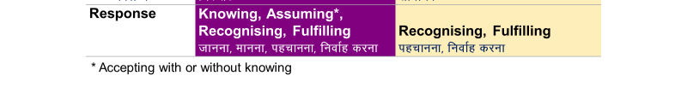
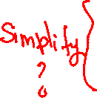
Human Being Ekkuo | Self eSa | Body “kjhj
Need vko';drk | Happiness (e.g. Respect) lq[k ¼tSls lEeku½ | Physical Facility (e.g. Food) lqfo/kk ¼tSls Hkkstu½
In Time dky esa | Continuous fujUrj | Temporary lkef;d
In Quantity ek=k esa | Qualitative (is Feeling) xq.kkRed ¼Hkko gS½ | Quantitative (Required in Limited Quantity) Ekk=kRed ¼lhfer ek=k esa½
Fulfilled By iwfrZ ds fy, | Right Understanding & Right Feeling lgh le>] lgh Hkko | Physio-chemical Things HkkSfrd&jklk;fud oLrq
Activity fØ;k | Imagination (Feeling, Thought, Expectation)… dYiuk”khyrk ¼bPNk] fopkj] vk”kk½--- | Eating, Walking… [kkuk] pyuk---
In Time dky esa | Continuous fujUrj | Temporary lkef;d
Response fuokZg | Choice चयन की स्वतंत्रता (Depends on the World-vision/Understanding or Assumptions) | Definite, No Choice निश्चित
Co-existence
lg-vfLrRo
Consciousness pSrU; | Material tM+

Slide 53
Process
Whatever is said is a Proposal (Do not assume it to be true or false)
Verify it on Your Own Right – on the basis of your Natural Acceptance
It is a process of Dialogue
A dialogue between me and you, to start with
It soon becomes a dialogue within your own self
between what you are and what you really want to be (your natural acceptance)
The purpose of this workshop is to initiate this internal dialogue
izLrko gS ¼ekuas ugha½
tk¡pas & Lo;a ds vf/kdkj ijA
viuh lgt LohÑfr ds vk/kkj ijA
;g laokn dh izfØ;k gSA
;g laokn vkids vkSj esjs chp 'kq: gksrk gS] fQj vki eas pyus yxrk gSA
More

Slide 54
Process
प्रक्रिया
It is a Proposal
Verify it – on your own right
– on the basis of your Natural Acceptance
(Do not assume it to be true or false)
It is a process of Dialogue
A dialogue between me and you, to start with
It soon becomes a dialogue within yourself
between what you are and
what you really want to be
(your natural acceptance)
The purpose of this workshop is to initiate/strengthen this internal dialogue
यह एक प्रस्ताव है
जाँचें – स्वयं के अधिकार पर
– अपनी सहज स्वीकृति के आधार पर
(मानें नहीं – न सही मानें, न ही गलत मानें)
यह संवाद की प्रक्रिया है
यह संवाद मेरे और आप के बीच शुरू होता है
फिर आप में चलने लगता है
जैसा आप हैं और
जैसा होना आप वास्तव में होना चाहते हैं
(आपकी सहज स्वीकृति)
इस कार्यशाला का आशय
इस संवाद को शुरू / मज़बूत करना है

Slide 55


Process
प्रक्रिया
It is a Proposal
Verify it – on your own right
– on the basis of your Natural Acceptance
(Do not assume it to be true or false)
It is a process of Dialogue
A dialogue between me and you, to start with
It soon becomes a dialogue within yourself
between what you are and
what you really want to be
(your natural acceptance)
The purpose of this workshop is to initiate/strengthen this internal dialogue
यह एक प्रस्ताव है
जाँचें – स्वयं के अधिकार पर
– अपनी सहज स्वीकृति के आधार पर
(मानें नहीं – न सही मानें, न ही गलत मानें)
यह संवाद की प्रक्रिया है
यह संवाद मेरे और आप के बीच शुरू होता है
फिर आप में चलने लगता है
जैसा आप हैं और
जैसा होना आप वास्तव में होना चाहते हैं
(आपकी सहज स्वीकृति)
इस कार्यशाला का आशय
इस संवाद को शुरू / मज़बूत करना है
reflective question
Poll Qs:
Which process is naturally acceptable
Which process is Naturally Acceptable to you?
1) A process of self-exploration, self-verification on your own right, leading to understanding in yourself
2) A process of do’s & don’ts, in which you assume what is said, without verification

Slide 56

Activities of Self eSa dh fdz;k,a
Evaluative question
1.
2.
3. | Desire bPNk
4. | Thought fopkj
5. | Expectation vk'kk
Imaging fp=.k
Analysing-Comparing fo'ys"k.k&rqyu
Selecting-Tasting p;u&vkLoknu
Self eSa
1. Proposal
Poll Qs:
Are you able to see your imagination?
Imagination
dYiuk”khyrk
Extra Information?
2. Examples
of imagination
Information
Body 'kjhj
Behaviour O;ogkj
Work dk;Z

Slide 57
Activities of Self eSa dh fdz;k,a
Evaluative question
1.
2.
3. | Desire bPNk
4. | Thought fopkj
5. | Expectation vk'kk
Imaging fp=.k
Analysing-Comparing fo'ys"k.k&rqyu
Selecting-Tasting p;u&vkLoknu
Self eSa
1. Proposal
Poll Qs:
Are you able to see your imagination?
Imagination
dYiuk”khyrk
Removed this Information
2. Examples
of imagination
Body 'kjhj
Behaviour O;ogkj
Work dk;Z

Slide 58
Self UHV-I
3a. Evaluative question
1. Proposal
Poll Qs:
Are you able to see your imagination?
Imagination
(Desire, Thought, Expectation)
I want to be respected…
good teacher…
need some more…
Have to show them…
take revenge…
3b. Exploratory question
Self
Co-existence
Poll Qs:
What do you see in your imagination? Right now
2. Examples
of content of imagination
Body

Slide 59
Self UHV-I
Natural Acceptance
To be happy
To keep body healthy
To live in relationship
Guide?
Imagination
(Desire, Thought, Expectation)
I want to be respected…
good teacher…
need some more…
Have to show them…
take revenge…
Self
Co-existence
Body
Behaviour O;ogkj
Work dk;Z

Slide 60
Self UHV-II, Refresher 1 Part 1
1.
2.
3. | Desire bPNk
4. | Thought fopkj
5. | Expectation vk'kk
Activity fØz;k
Imaging fp=.k
Analysing-Comparing fo'ys"k.k&rqyu
Selecting-Tasting p;u&vkLoknu
Meaning
What I want to BE within
How to go about it How to fulfil the desire or expectation
What I want to GET from outside What I want to DO outside…
Natural Acceptance
Imagination
(Desire, Thought, Expectation)

Slide 61
Self Refresher 1 Part 2, Refresher 2, etc.
 | Power “kfDr | Dynamic Activity xfr fØz;k | State Activity fLFkfr fØz;k
1. |  | Authentication Áek.k | Realization vuqHko
2. |  | Determination ladYi | Understanding cks/k
3. | Desire bPNk | Imaging fp=.k | Contemplation fparu
4. | Thought fopkj | Analysing fo'ys"k.k | Comparing rqyu | Unguided Senses, Health, Profit
5. | Expectation vk'kk | Selecting p;u | Tasting vkLoknu | Unguided Sensation
Natural Acceptance
B1
Imagination
(Desire, Thought, Expectation)
B2

Slide 62
Self Refresher 1 Part 2, Refresher 2, etc.
 | Power “kfDr | Dynamic Activity xfr fØz;k | State Activity fLFkfr fØz;k
1. |  | Authentication Áek.k | Realization vuqHko | Co-existence lg&vfLrRo
2. |  | Determination ladYi | Understanding cks/k | Harmony in Nature O;oLFkk
3. | Desire bPNk | Imaging fp=.k | Contemplation fparu | Participation in Larger Order, Relationship O;oLFkk esa Hkkxhnkjh
4. | Thought fopkj | Analysing fo'ys"k.k | Comparing rqyu | Co-existence, Harmony, Justice Guided Senses, Health, Profit
5. | Expectation vk'kk | Selecting p;u | Tasting vkLoknu | Goal, Value Guided Sensation
Natural Acceptance
B1
Imagination
(Desire, Thought, Expectation)
B2

Slide 63
Sum Up 1. Review of Content and Presentations
Is the content for this type of workshop adequately covered
(in sequence, not too much or too little, etc.)? This part is strong already
but may be reviewed
Are the key points adequately highlighted? This part can be reviewed
e.g. in intro FDP
knowing-assuming may need to be made less in-depth
prosperity may need to be covered in more depth
Highlight key points to be shared on each slide… This part can be reviewed
Use “UHV Theme 2022” associated presentation standards
e.g. “explore and verify” in bottom right

Slide 64
2. Polls
Keep them simple
Check for listening and self-evaluation, self-verification
Are we pausing at the key points and polling at most important key points? → Add polls at most important key points
What kind of questions would be appropriate to ask and what kind of questions are we asking? → Update the questions to most appropriate questions
Are we inadvertently contradicting the content through the poll questions? → update qs
Are we polling too often or too infrequently? → add/delete qs, rationalise the number of polls
Can the poll responses be analysed for their present state of mind? → maybe?

Slide 65
Exploratory & Reflective Questions
Evaluative or Other types of Questions
To be happy
To keep body healthy
To live in relationship
Natural Acceptance
Natural Acceptance
My Assumptions, likes-dislikes, experience of events…
Imagination
(Desire, Thought, Expectation)
Imagination
(Desire, Thought, Expectation)
Exploratory questions, “what is it”
(the reality)
Self-verification → understanding the reality (self, body, family, society, nature/existence)
Reflective questions, “what is my role with it”
Self-exploration → understanding my role with it
Evaluative questions about me,
“do I know it, am I fulfilling my role with it”
(to decide program for my self-improvement
or just to stop at finding out what is wrong with me?)
Evaluative questions about other, the situation
(to ensure comlementarity or with some other view?)

Slide 66
Sample Poll / Quiz / Test Question
If happiness is to be in harmony, then happiness is the same for everybody
Options:
  1. Strongly agree
  2. Agree
  3. Neither agree nor disagree
  4. Disagree
  5. Strongly disagree
Please respond to the options after reading the following statements
A. I am happy when I am in harmony
B. I am unhappy when I am in disharmony
C. Others must be in harmony when they are happy
D. Others must also be feeling unhappy when they are in disharmony
Options:
I am able to see
  A and B only
  A, B and C only
  A, B, C and D
  None of the above
Evaluative questions
Comparing with my assumptions
Exploratory question
Exploring “What is Happiness”

Slide 67
Sum Up 2. Polls
Keep them simple
Check for listening and self-evaluation, self-verification
Guidelines:
Ask more of exploratory and reflective questions
e.g. ask questions about “what is naturally acceptable”, “can you see”…
Ask questions about what was proposed and what was not proposed (check for listening)
Keep questions about “what is not” to a minimum. e.g. what trust is not
When asking evaluative questions, ask how it can help in their self-development plan, in their program for complimentarity, etc.
Do not ask “agree or disagree”

Slide 68
3. Quizzes and Tests
Quiz – with listening in focus (similar to polls)
Test – with listening + some self-reflection, self-verification in focus
If possible, analyse some test responses – are the responses in a normal distribution? Are they skewed – too easy or too difficult?
Keep randomisation possibility while coding
[Note: since we are using Zoom for polls, quizzes and tests, only MCQs are available. If we could use complementary tools, we could use other types of questions also]

Slide 69
4. Assignments – Practice-session type, family/activity oriented
Have clearly heard the proposal?
Have been able to self-explore, self verify?
Have been able to reach to the expected conclusion on their own right?
e.g. practice exercise to write the activities of the Self and Body
e.g. practice exercise to explore "what is prosperity" and evaluate "is my family having a feeling of prosperity" and make a program for "prosperity in my family"
MCQ or write key takeaway
Have been able to evaluate common misunderstandings also, while exploring?
e.g. ask them to read a passage and respond to some quiz-type questions or write a summary, say read the passage about trust and
distinguish between trust on intention (vishwaas) and “trust” on competence (bharosa?)
Distinguish between intention and desire
Have been able to connect with living and experiment (may be too soon to expect)

Slide 70
Assignments
Since we are using Google forms (or Quiz) for this, there are several options available:
these can be automatically scored
1. MCQ
2. Multiple right options
3. …
These can not be automatically scored
4. Text responses

Slide 71
5. Pre-post FDP Surveys – with impact or change in focus
Ask MCQs, multiple selection and other types of questions, through which the initial state of mind and the post FDP state of mind (shift in perspective) can be gauged
e.g. on a scale of 1-5… respond to questions like
- Money is the most important thing in life
- Trust is built over a period of time with each person
Ultimately, connect to parameters related to:
Common Graduate Attributes
Human development Index
Full Human Potential
Humane society (equitable and just society)
Development of the Nation
Note that poll, quiz, test and assignment questions can be included in this type of analysis

Slide 72
6. Handouts/Class Notes
Relevant portions of Teachers Manual / Text Book in PDF format
All material can be placed neatly on the website with links to YouTube etc.

Slide 73
Expectations from Workshops
Umesh Jadhav

Slide 74
Introductory Workshop (To prepare faculties for Mentoring)
UJ
Objective: To draw attention on the Basic human aspiration is continuous happiness and its fulfillment through understanding of Harmony at all 4 levels and living accordingly
Expected outcome: There is a need to develop Right Understanding, Relationship within to fulfil the basic aspiration.
Content: Role of Education in Holistic development (Basic Aspiration and its fulfilment) Self Exploration, Happiness and Prosperity (prevailing notions and true meaning), Understanding Harmony in Human Being, Understanding Harmony in Self, Health and Prosperity, Understanding Harmony in Family (9 feelings), Understanding Harmony in Society (Human goal, basic introduction to foundational systems, Education/Sanskar), Understanding Harmony in Nature(Mutual fulfilment and enrichment), Understanding Harmony in Existence

Slide 75
Refresher 1 Part 1 workshop (To prepare faculties for teaching UHV I)
UJ
Objective: To draw the attention on current issues, concerns and problem – what and how do we provide solution at individual level / collective level?
To explore on what we want to be, Exploring within to find out the best possible solution
Expected outcome: To live fulfilling life there is a need to explore Basic Human aspiration/purpose and also to understand how to fulfil it.
Content: Concerns, Problems, Issues, Aspirations, Basic Aspiration, best possible solution – Happiness and Prosperity (prevailing notions and true meaning), Value education and skill education, Understanding Harmony in Human Being (need, fulfilled by, activities), Activity of self (Three motivations), Health, Relationship(Trust, Respect, Affection, Reverence, Gratitude and Love), Human goal (Education and sanskar as foundation of fundamental system), Nature (Mutual fulfilment and enrichment)

Slide 76
Assignments/Exercise/Practice session: For Example
UJ
A.
1. Prepare the list of your concern/Problems/Issues
2. Categories it on the basis of Individual, family, society, nation, world and nature
3. Ask your 2 family members Or 2 friends to Prepare the list of their concern/Problems/Issues
4. Ask your 2 family members Or 2 friends to Categories their list on the basis of Individual, family, society, nation, world and nature
5. Take a comparative analysis and write your observation on % of common concerns/problems/Issues
Outcome: we all may have common concerns/problems/Issues
B.
1. Make a list of your aspirations and categories it on the basis of expect to become something and expecting to be something
2. Explore on: By fulfilling your each aspiration and all aspiration what you expect to be
3. Check with your 5 friends that they also do they also expect to be the same?
Outcome: There is a basic Aspiration and it’s same for all
C. 1. Refer the list of concerns/problems/issues from A and check that they are interlinked?
2. Identify the basic root of your concerns/problems/issues
3. What is necessary to solve your concerns/problems/issues?
D. 1. Refer to the list of your Aspirations and identify what is necessary to fulfil our basic aspiration.
Outcome: The basic root is Right Understanding
2. Share the observations and outcome of A,B,C,and D with your family and friends.

Slide 77
Refresher 1 Part 2 workshop (To prepare faculties for UHV II)
UJ
Objective: To draw attention on Right Understanding and right feelings within is Harmony. The completeness of Right Understanding is Continuous Happiness.
Expected outcome: There is need to explore, verify and evaluate within to live with continuity of Happiness.
Content: Role of Education in Holistic development (Basic Aspiration and its fulfilment) Self Exploration, Happiness and Prosperity (prevailing notions and true meaning), Understanding Harmony in Human Being, Understanding Harmony in Self, Health and Prosperity, Understanding Harmony in Family (9 feelings), Understanding Harmony in Society (Human goal, foundational systems), Understanding Harmony in Nature(Mutual fulfilment and enrichment), Understanding Harmony in Existence

Slide 78
Workshops to Prepare PRP and RP
UJ
Next workshop (UHV III, to prepare PRP)
Objective: To draw attention on self – development through exercise 1 and exercise 2 and living accordingly
Expected outcome: There is need to practice exercise 1 and exercise 2 continuously to ensure happiness within.
Next workshop (Exercise 1&2, to prepare RP)
Objective: To draw the attention on experiential validation of proposals in living with human being and Rest of Nature
Expected outcome: There is need to live with natural acceptance and participate at all 4 levels to validate the proposal.

Slide 79
Other Workshops
UJ
Another workshop (UHV IV, to prepare for societal transformation)
Objective: To draw the attention on possibility of societal transformation through personal transformation and participation
Expected outcome: There is a need to participate in one or more dimensions (foundational system) to fulfill the human goal.
Another workshop (UHV V, to prepare Aacharya)
Objective: To draw the attention on concept of co-existence, Harmony and Relationship (Truth, Love and Compassion) is experimented, explained and practiced in Various Darshan
Expected outcome: There is a need to authenticate realization in living
Another workshop (The Essence, to prepare human being living with continuous happiness, satisfaction, peace and bliss)
The expected outcome: Human being living with Truth, Love and Compassion

Slide 80
Expectations from Workshops
Kumar Sambhav

Slide 81
Expectation from a Workshop
KS
The participants are able to listen to the content
The participants feel related to the content, and feel encouraged to understand.
The resource person is able to convey the content correctly, with a feeling of relationship (the participants do not get hurt during the workshop)
The participants start self-exploring the content and get clarity about the content (to the extent the workshop is designed for)
The participants feel related to RP, team and effort

Slide 82
Factors determining the Outcome
KS
There are three major factors on which the outcome of the workshop depends:
  The competence of the RP (understanding, feeling, living, communication skill)
  The sanskar of the participants (receptivity, pre-conditionings, etc.)
  The environment for the workshop (place of being conducted, volunteers, mode of presentation etc.)
When participants come for refresher or higher level workshops, the major factors determining the outcome are:
  The association of the participant with the UHV team
  The effort by the participant between the two workshops (self-study, participation in meetings, interaction with RPs or team etc.)
  The role being played by the participant such as teaching a course, coordinator of program etc.
  One's own sanskar (e.g. self-motivated or deeply conditioned in some manner?)
  Support by family, institution, society etc.

Slide 83
Expectation from an Offline Introductory Workshop
KS
Participants are able to see
  There is a universal content for values
  There is natural acceptance based on which we can explore the reality
  Basic human aspiration
  Priority of right understanding, relationship and physical facility
  Sense of happiness in continuity, feeling of prosperity
  Existence of Self with the body
  Sources of imagination, and difference between self-organization and enslavement
  Responsibility of self towards the body
  Role of feeling in relationship
  Trust as the foundation, Intention and competence
  Respect as right evaluation, difference between respect and differentiation
  True meaning of love (vis-à-vis infatuation)
  Common human goal in a society, different dimensions of society
  Four orders in nature
  Presence of nature in space

Slide 84
Expectation from an Offline Refresher Workshop
KS
Participants are able to see in depth
  Basic guidelines for value education
  The natural acceptance is innate, and different from acceptance/conditioning
  Basic human aspiration is continuity of happiness and prosperity
  Correct priority of right understanding, relationship and physical facility, leading to development of consciousness
  Happiness = harmony, prosperity = feeling of having/producing more than required
  Co-existence of Self and body as human being
  Three sources of imagination in the self, and program to ensure self-organization over enslavement
  Responsibility of self towards the body, body as an instrument
  Role of feeling in relationship, feelings in the self
  Trust as the foundation, Intention being pure, competence different from intention
  Complete meaning of respect as right evaluation, difference between respect and differentiation
  True meaning of love, leading to undivided society
  The four common human goals in a society, and five dimensions of society
  Four orders in nature, their mutual fulfillment, difference between these orders, details of these orders
  Submergence of nature in space
  Holistic perception of existence
  Their participation in value based education

Slide 85
Expectation from an Offline UHV III Workshop
KS
Participants are able to see
  Basic aspiration as continuity of happiness
  Continuity of happiness through right understanding, right feeling, right thought
  Meaning of all-encompassing resolution
  Right understanding as knowing of self, existence and role of self in entire existence
  Self being central to human existence, as seer, doer and enjoyer
  Different dimensions of a unit
  The complete set of activities in the self (B1 and B2) with partial clarity of the activities of B1 (Realization of co-existence, Understanding of harmony and Contemplation of feelings in relationship)
  Different attributes of four orders, with the ability to distinguish the units of four orders
  Meaning of ‘submergence in space’, and ‘realization of submergence’
  Different steps of resolution
  Resolution of various doubts and queries related to self, submergence, proposals from tradition
  Their role in the existence, in the current system, program to live accordingly

Slide 86
Expectation from an Online Workshop
KS
Presently workshops are being held mostly in the online mode. A study of advantages and disadvantages is as follows:
  Advantages
    Easy access to large number of people in any part of the globe
    Can be conducted without foregoing routine work
    Multiple workshops can be conducted in parallel by the same team
    Less expenses, preparation, managerial work
    Re-doing quite simple as similar preparations involved
    Participants can attend workshops multiple times without much investment
    Follow up quite simple
    Good scope to pick people from different places and background with good sanskar
  Disadvantages
    Ensuring ‘listening’ a major challenge
    Disconnect or lesser connect with RPs and the team, sense of relationship less
    Lesser exploration in given time
Expectation and program for online workshops has to be fixed accordingly.
Expectation for different levels of workshops can be fixed based on corresponding offline workshops keeping the above in view.

